Slide 1
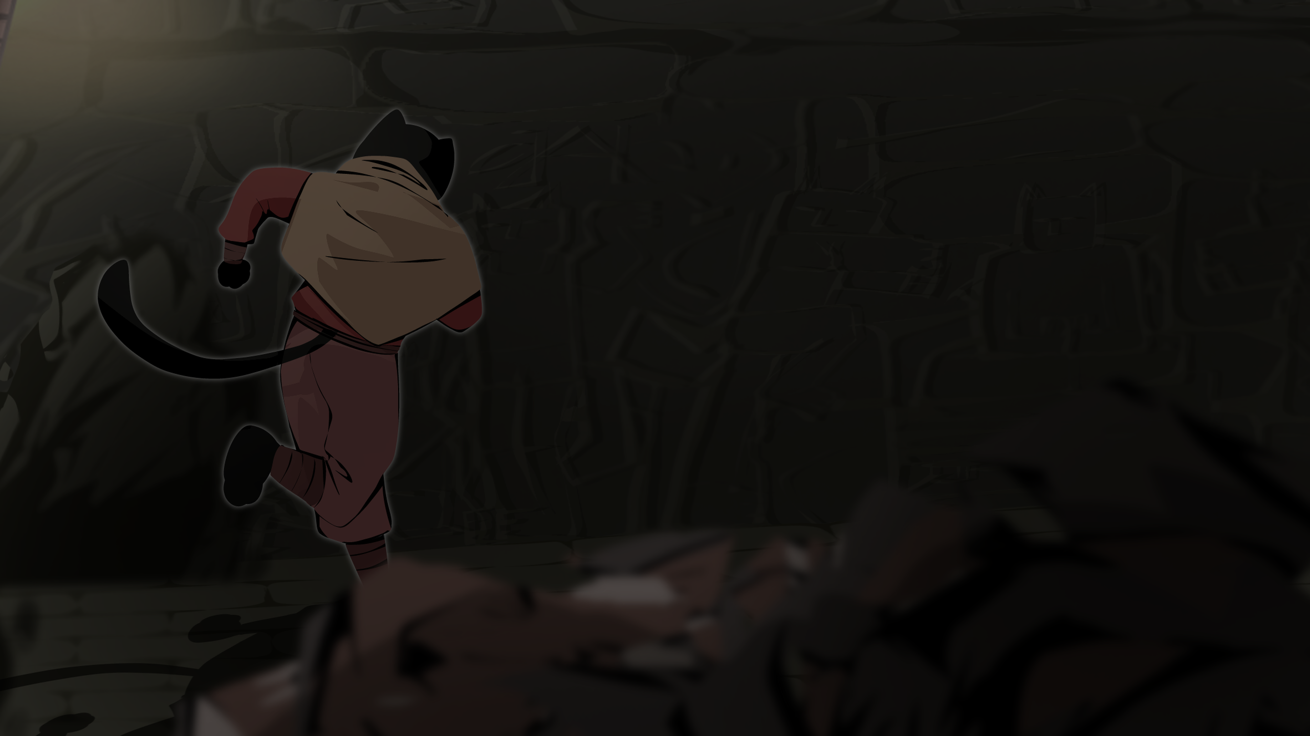
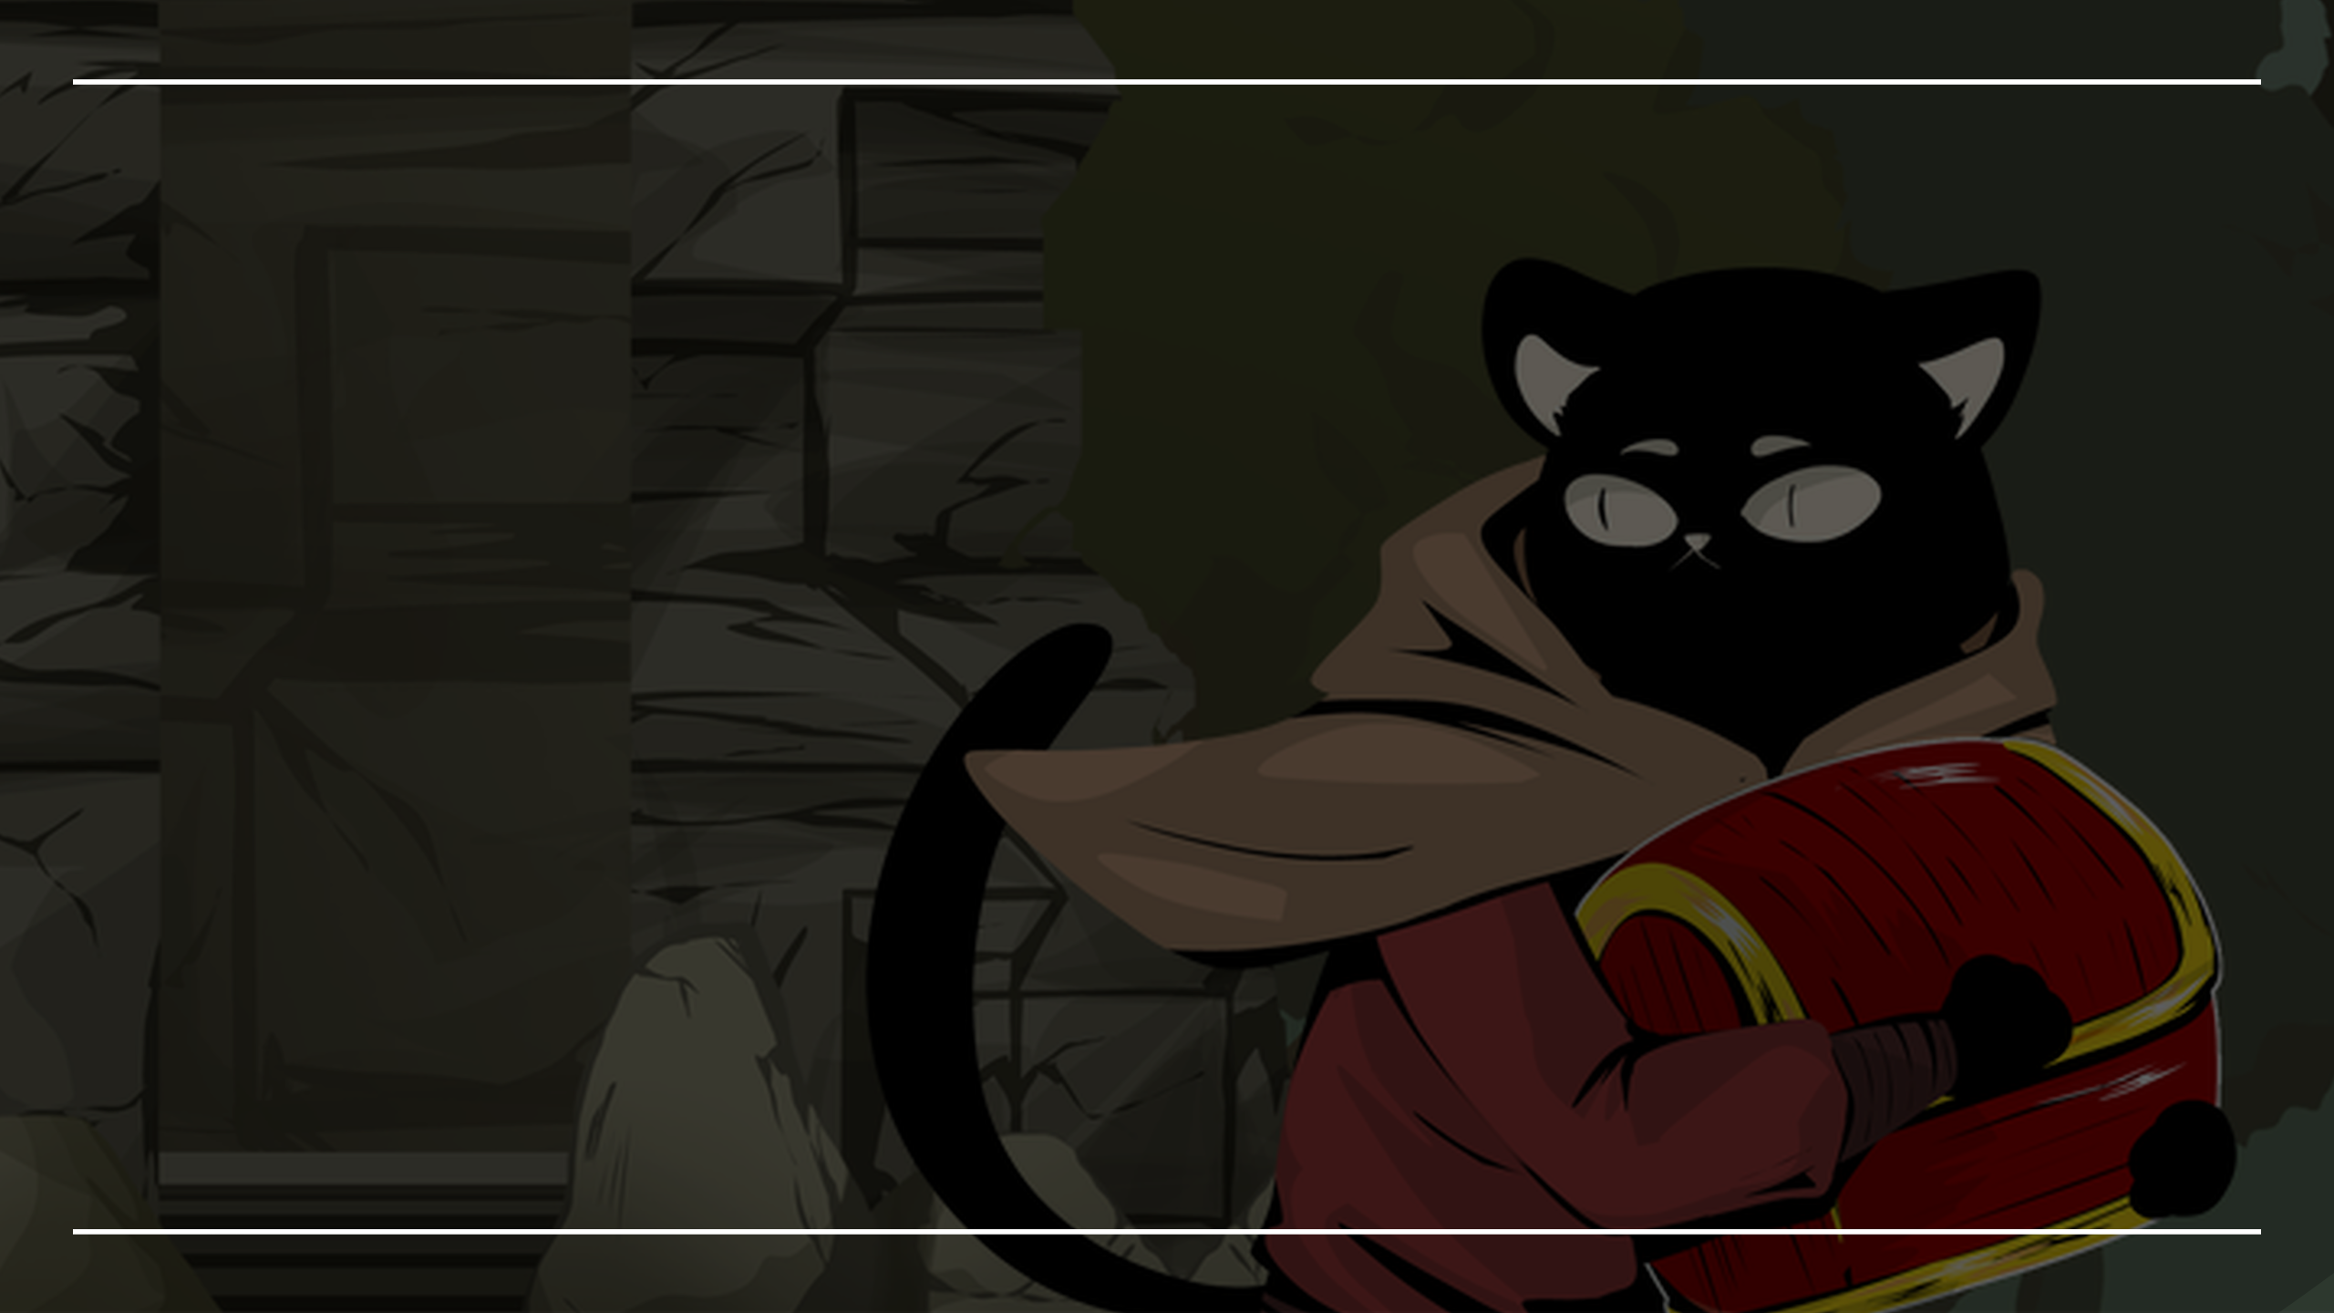



Slide 2
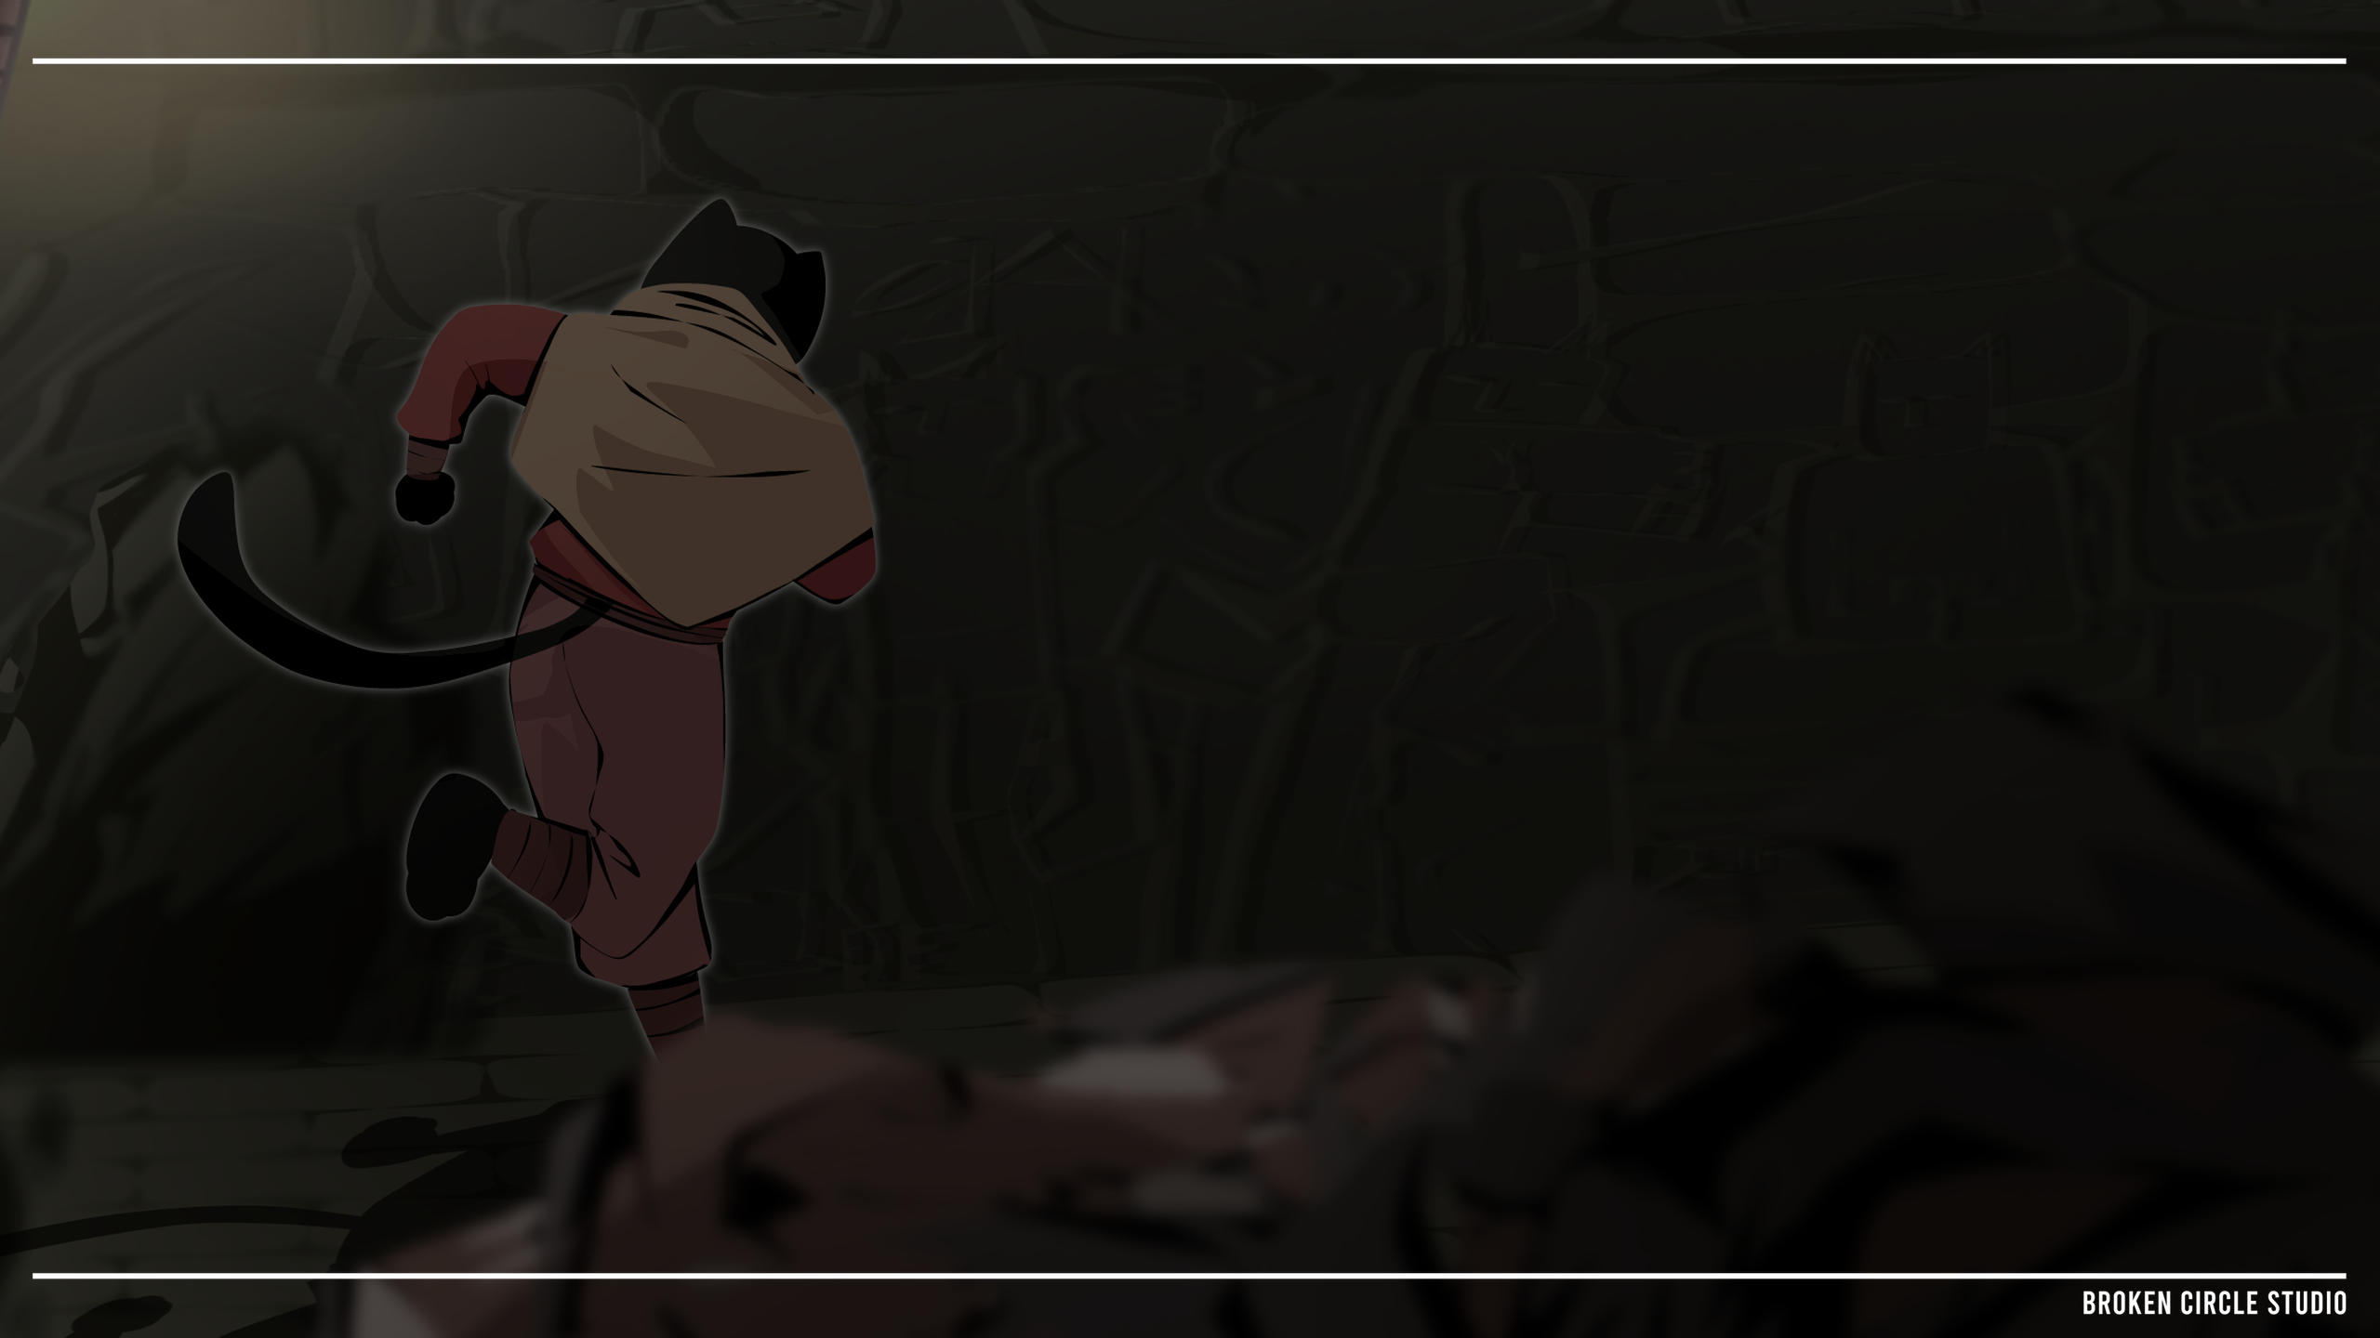
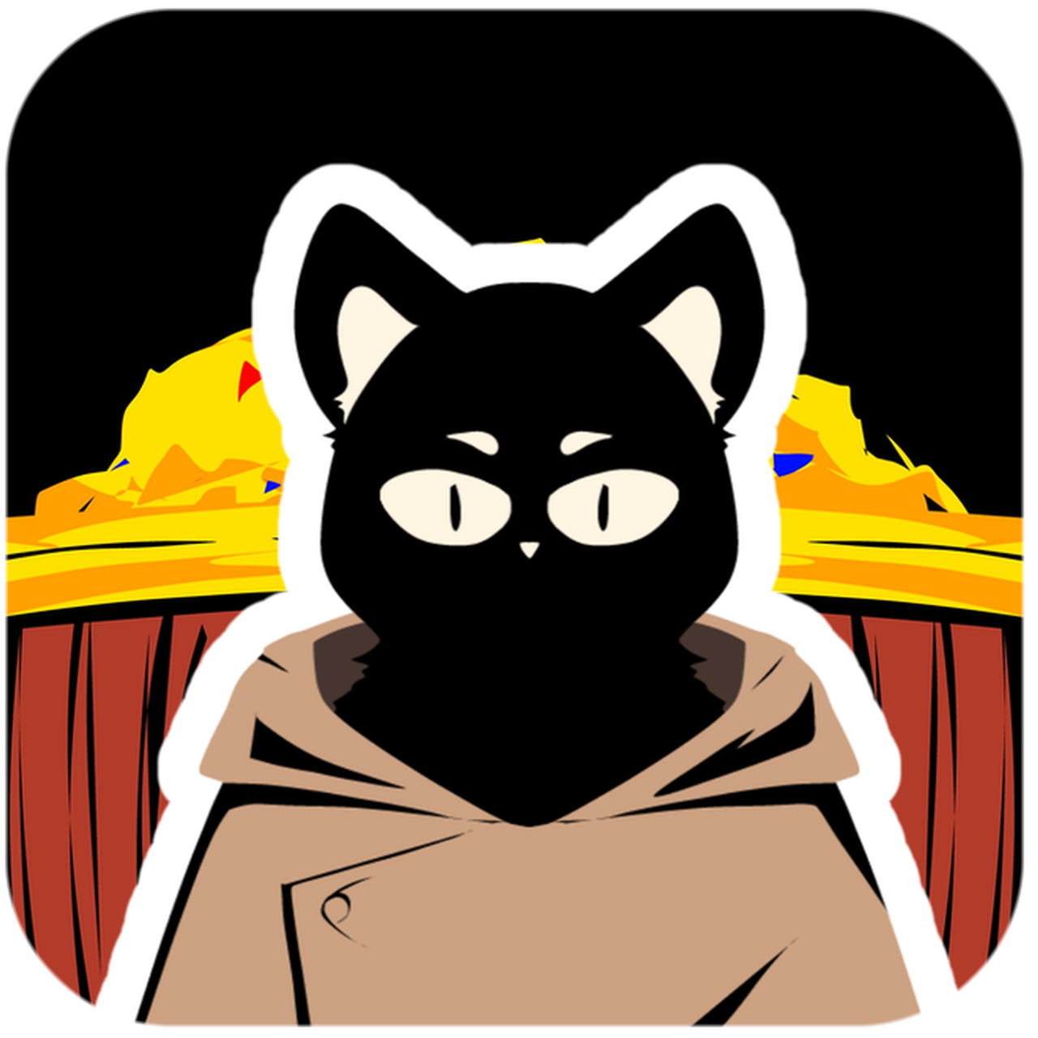
Find The Treasure
Find the treasure is an action adventure game which tells the story of Mero, a pirate cat who was sent by his captain to find a treasure in the Nusantara Island, and he must explore 3 place which is forest, temple and underground temple. And when the MC almost find the treasure he must his biggest enemy named Ki Gogo.

Slide 3
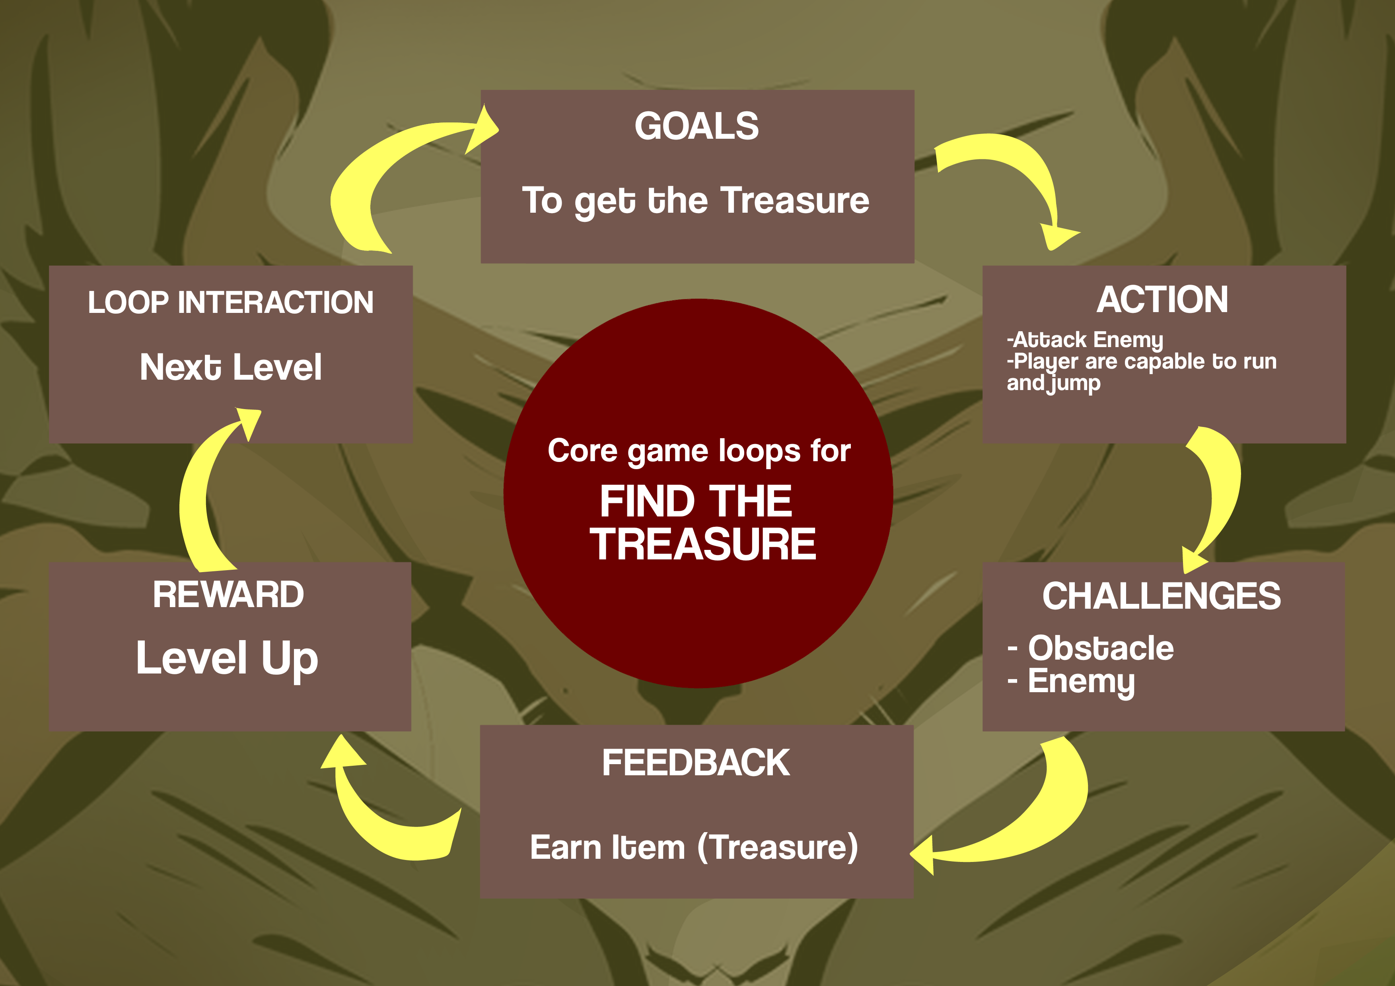
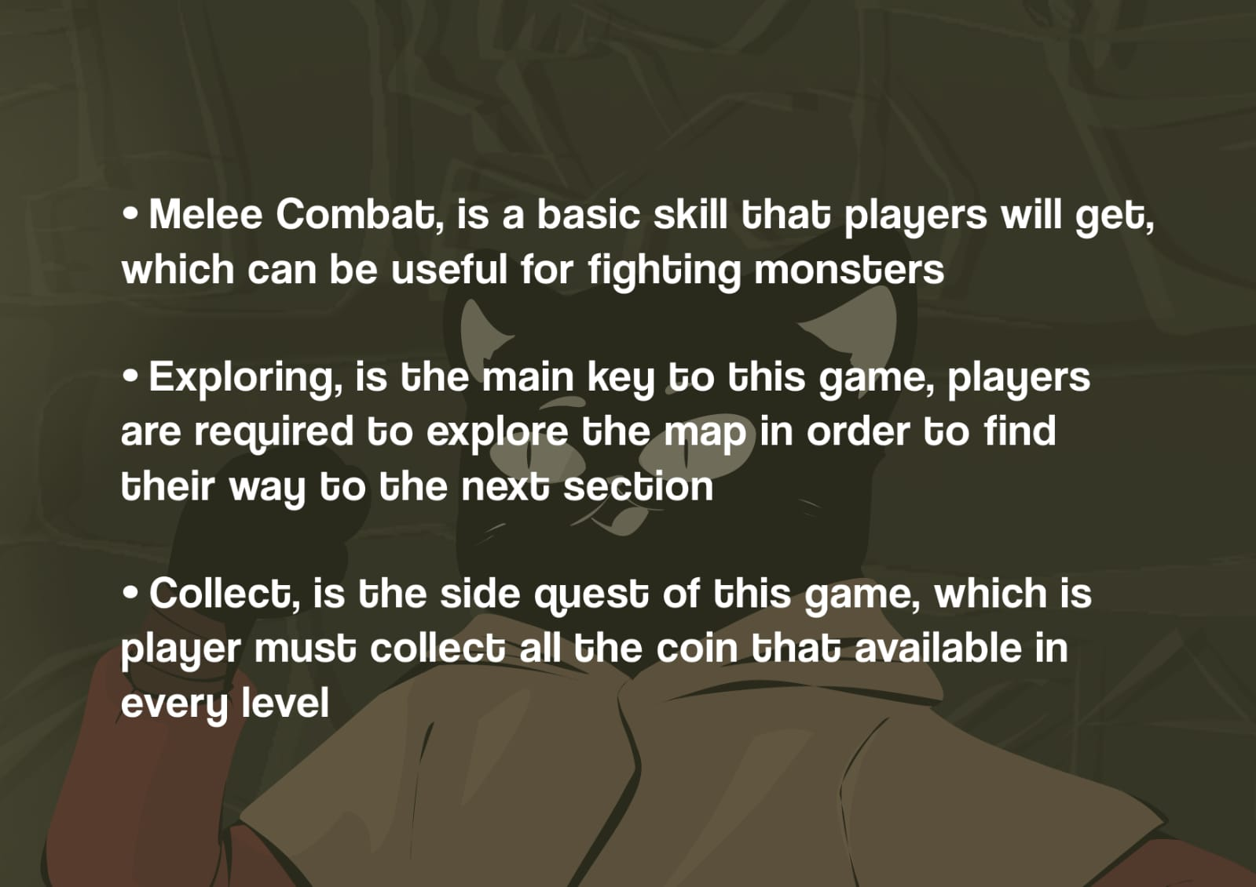
CORELOOPS
CORE MECHANIC

Slide 4

THEME
Target Audience
Style : Action , Adventure
Setting : Nusantara Tropical, Forest, Ancient Temple, Underground Temple
Genre : Platform , Exploration, Action
Male & Female
Age 12 - 25y.o
Midcore & Hardcore Players
Students and Workers

Slide 5
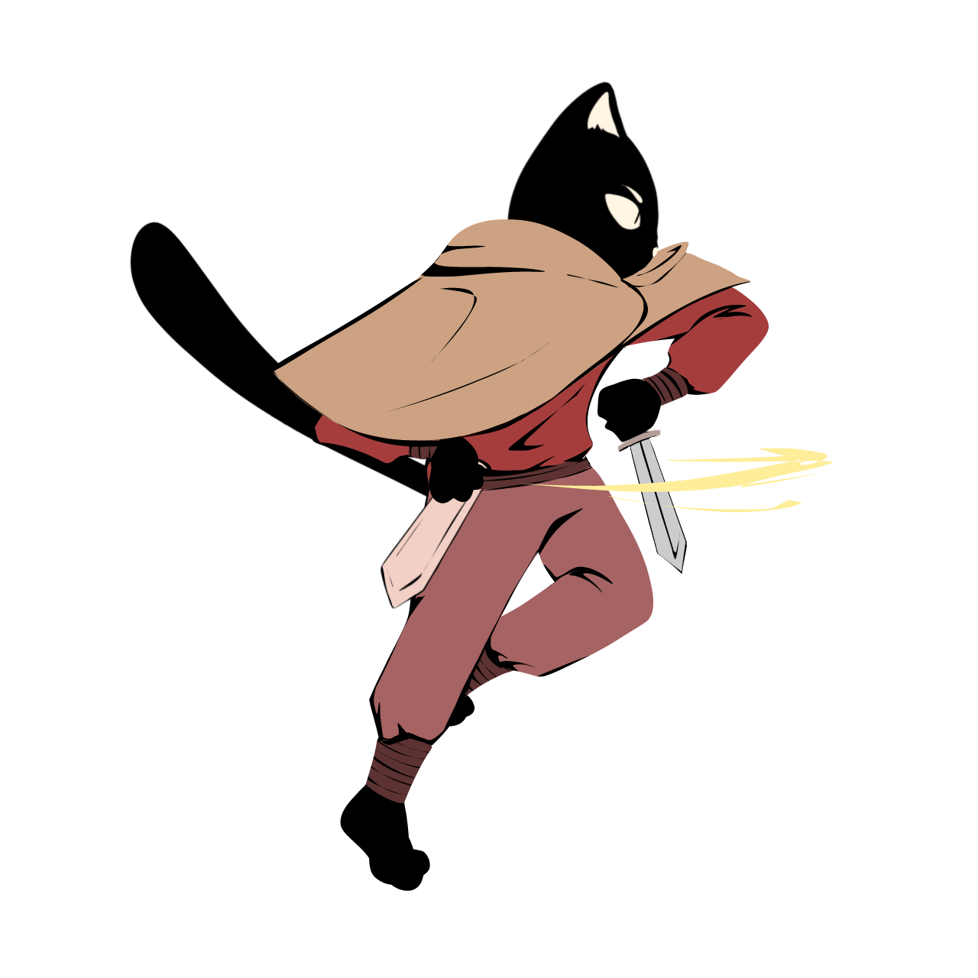
SYSTEMS (OPT)
Side View Camera Angle : Where the camera will follow the player's movements.
Control Character : Players can move left and right, jump, and can collect all item in the level like coin and life.
Exploration : Where players have to explore the map in order to find their way to the next destination.
Collecting : Where player can collect all the coin and life in every stage
Atmospheric : This game will present a game atmosphere with
a adventure action feell

Slide 6
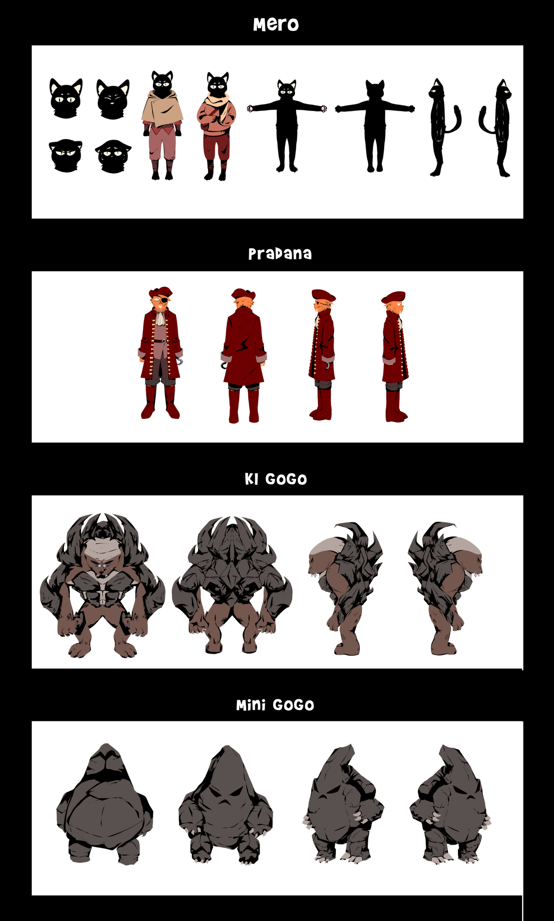
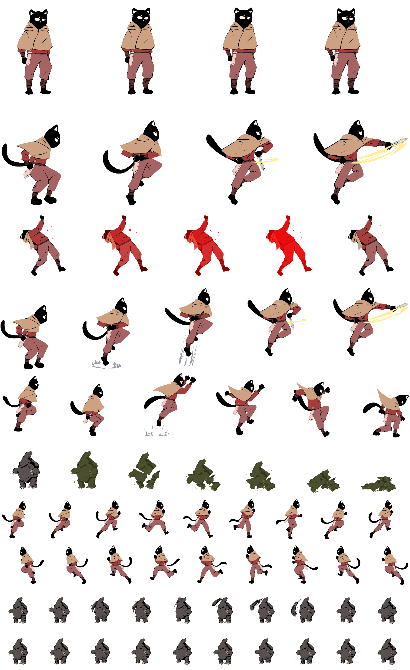
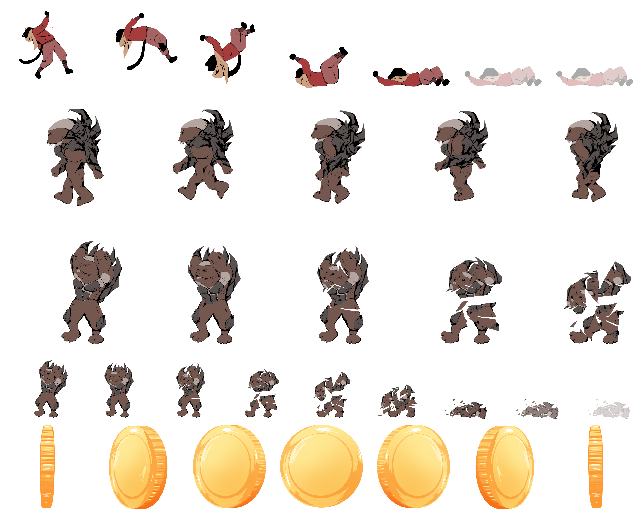
ART
Charachter
Animation Cycle

Slide 7
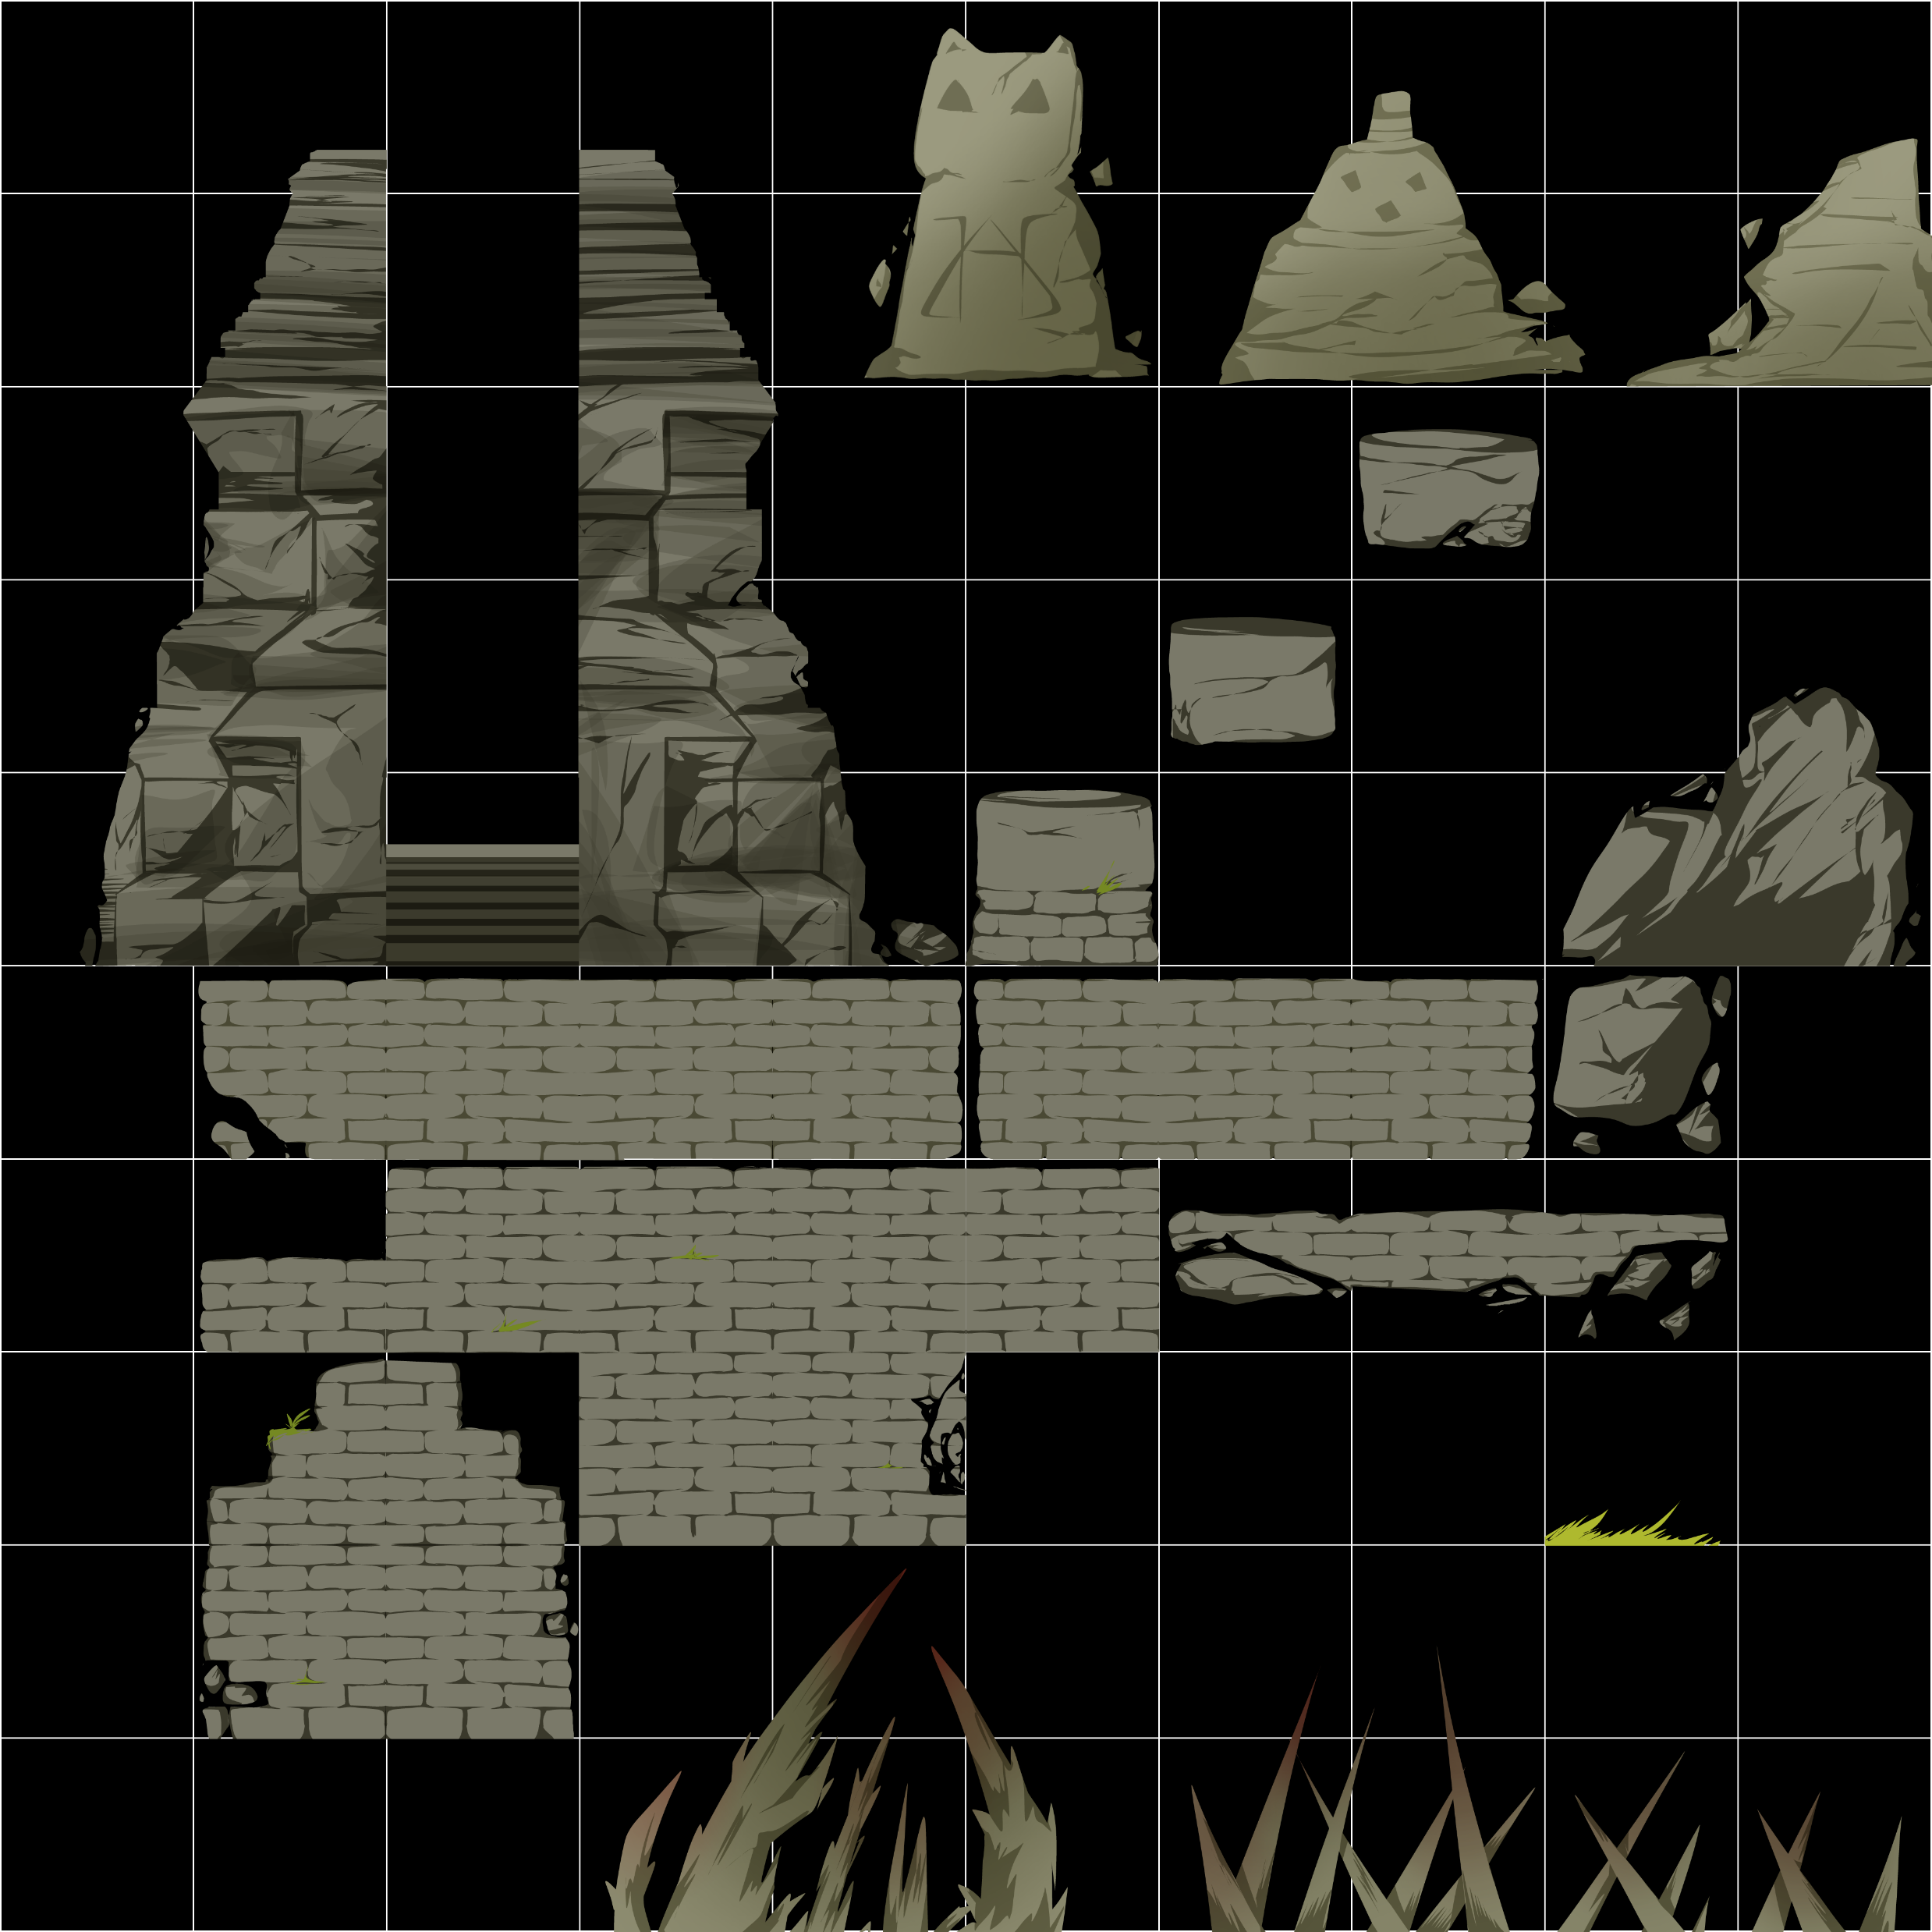
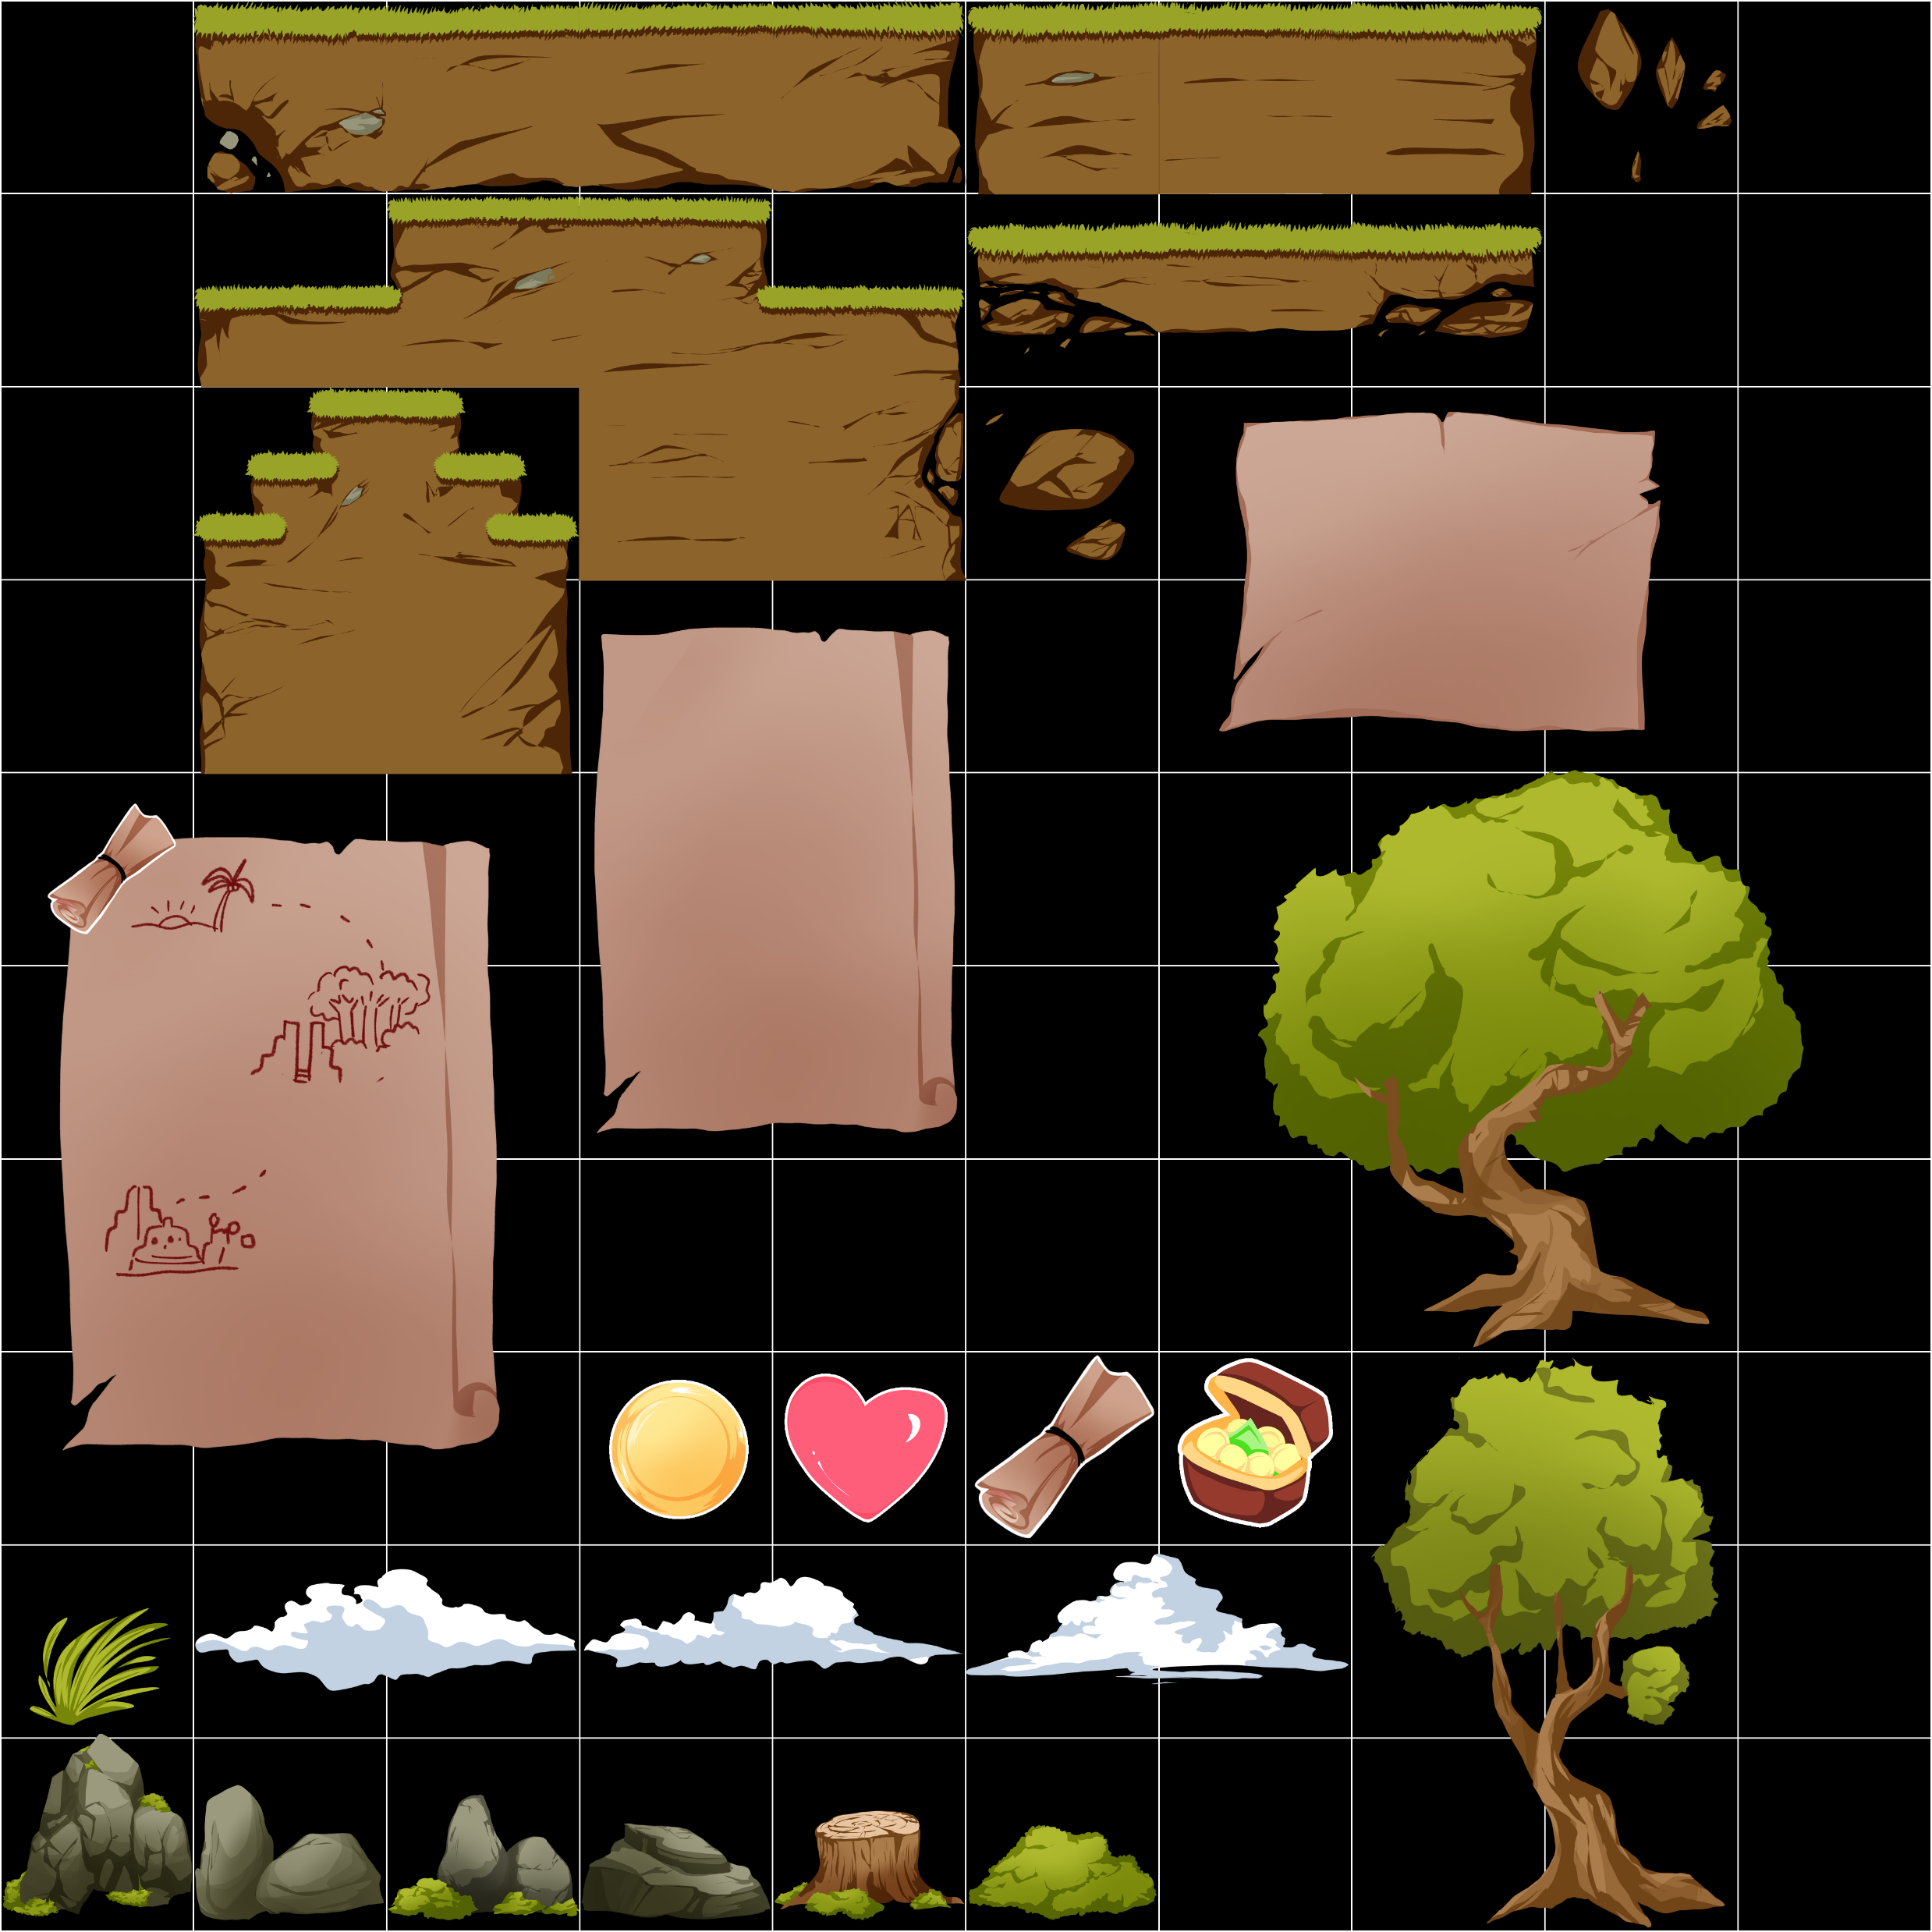
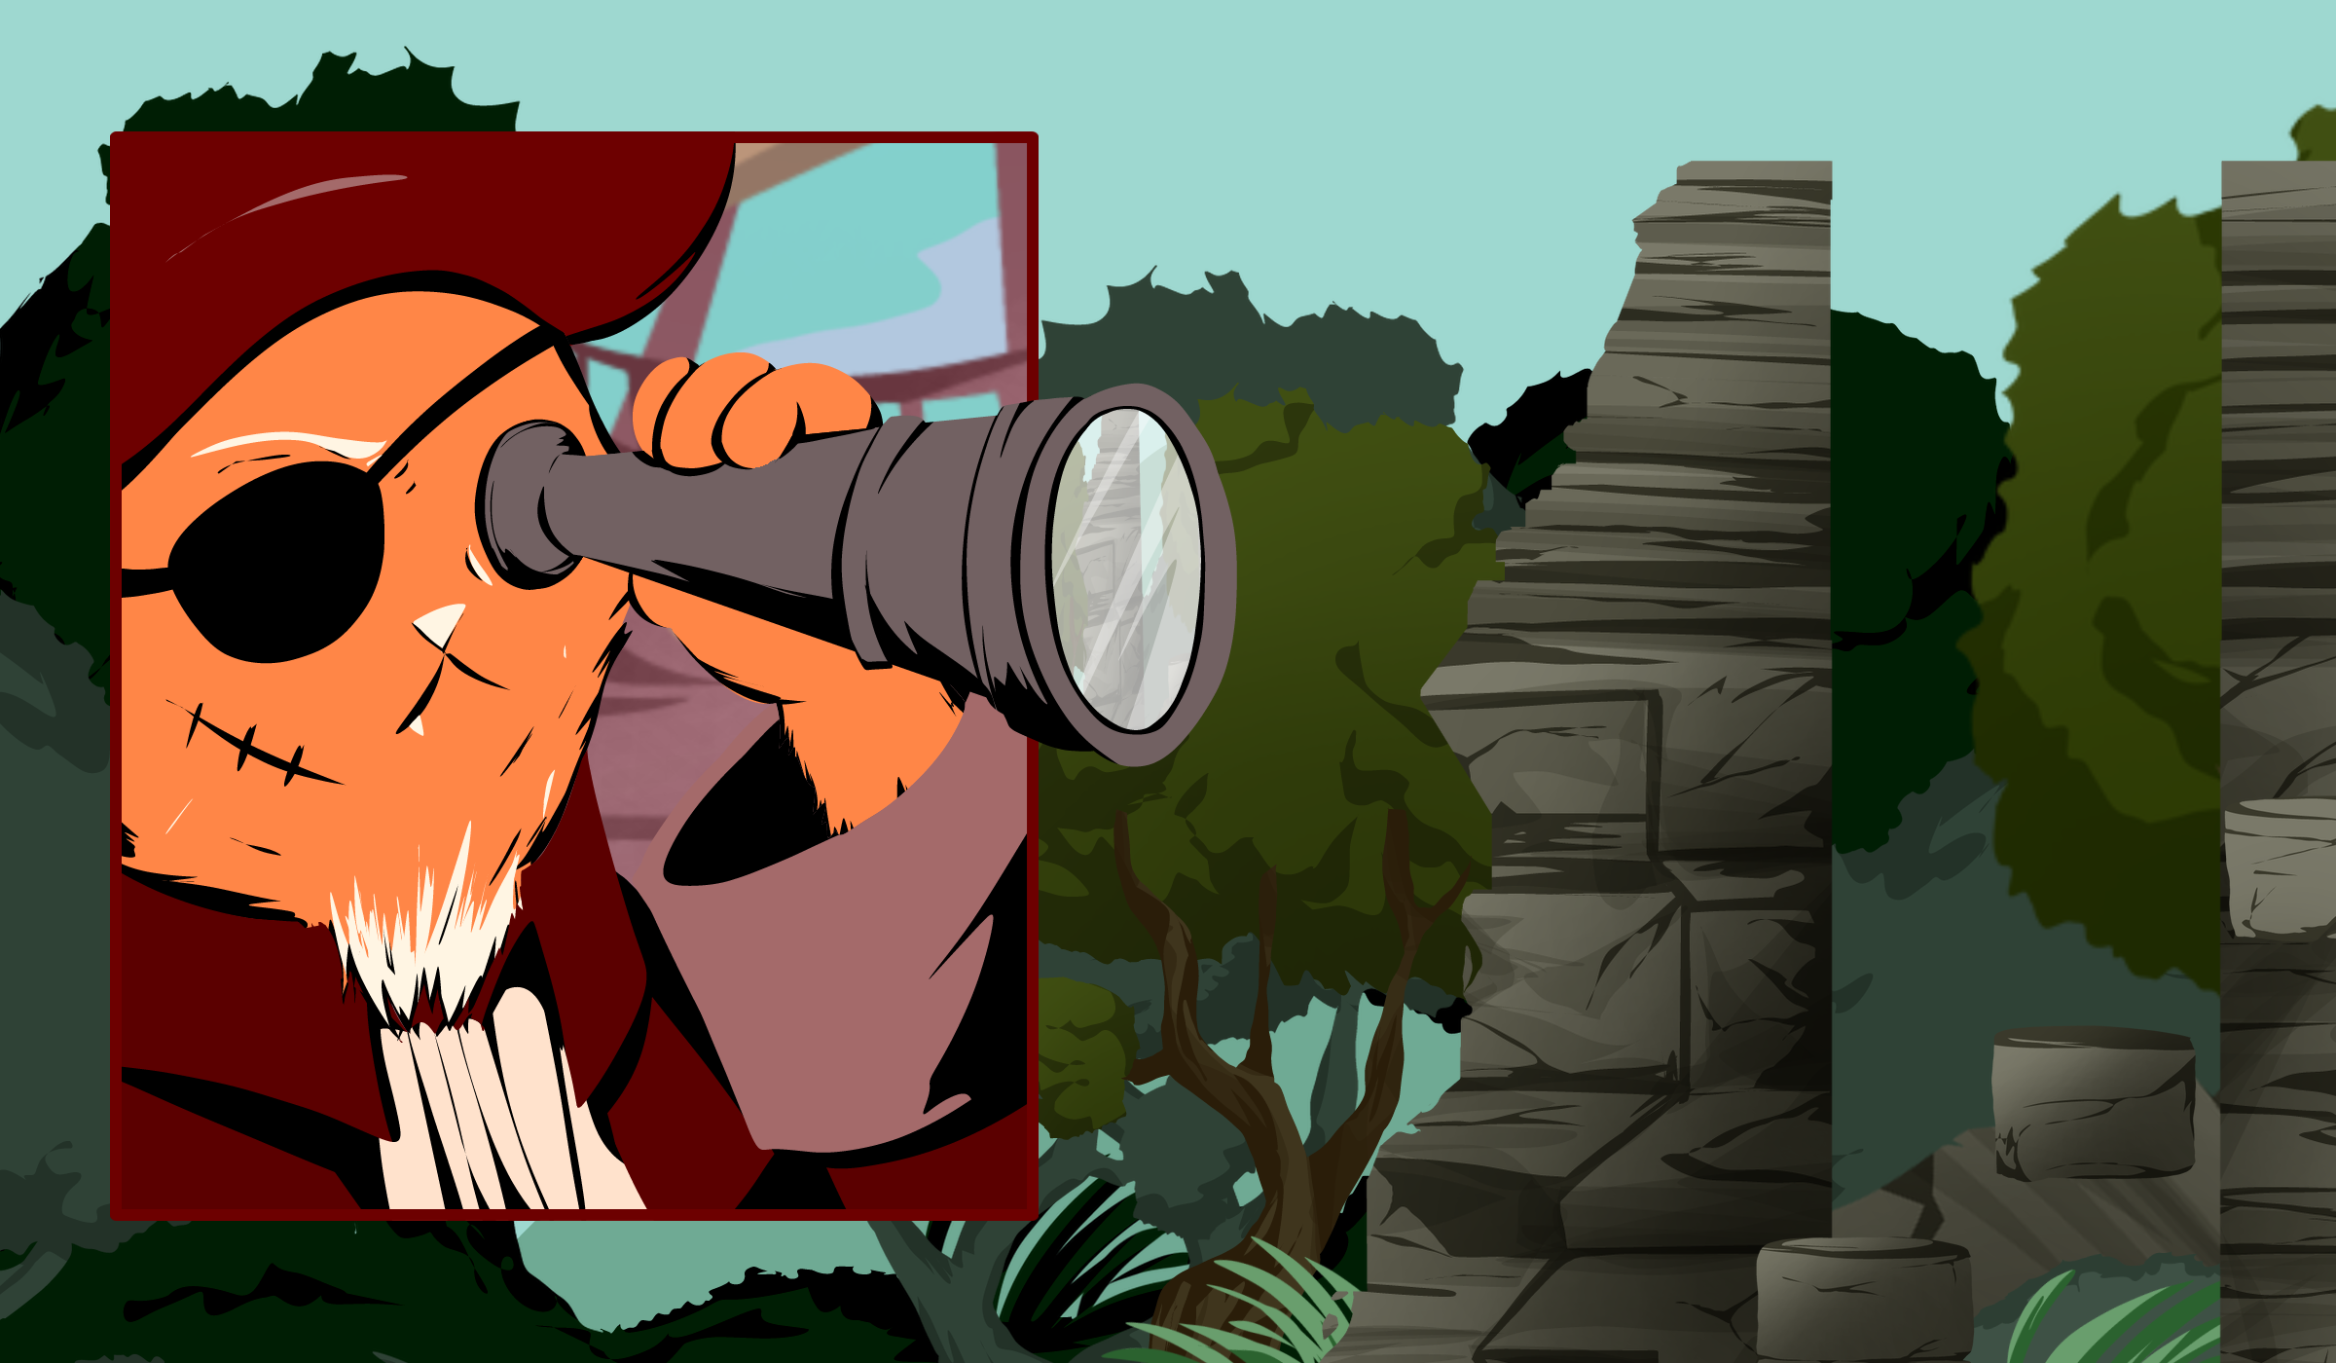
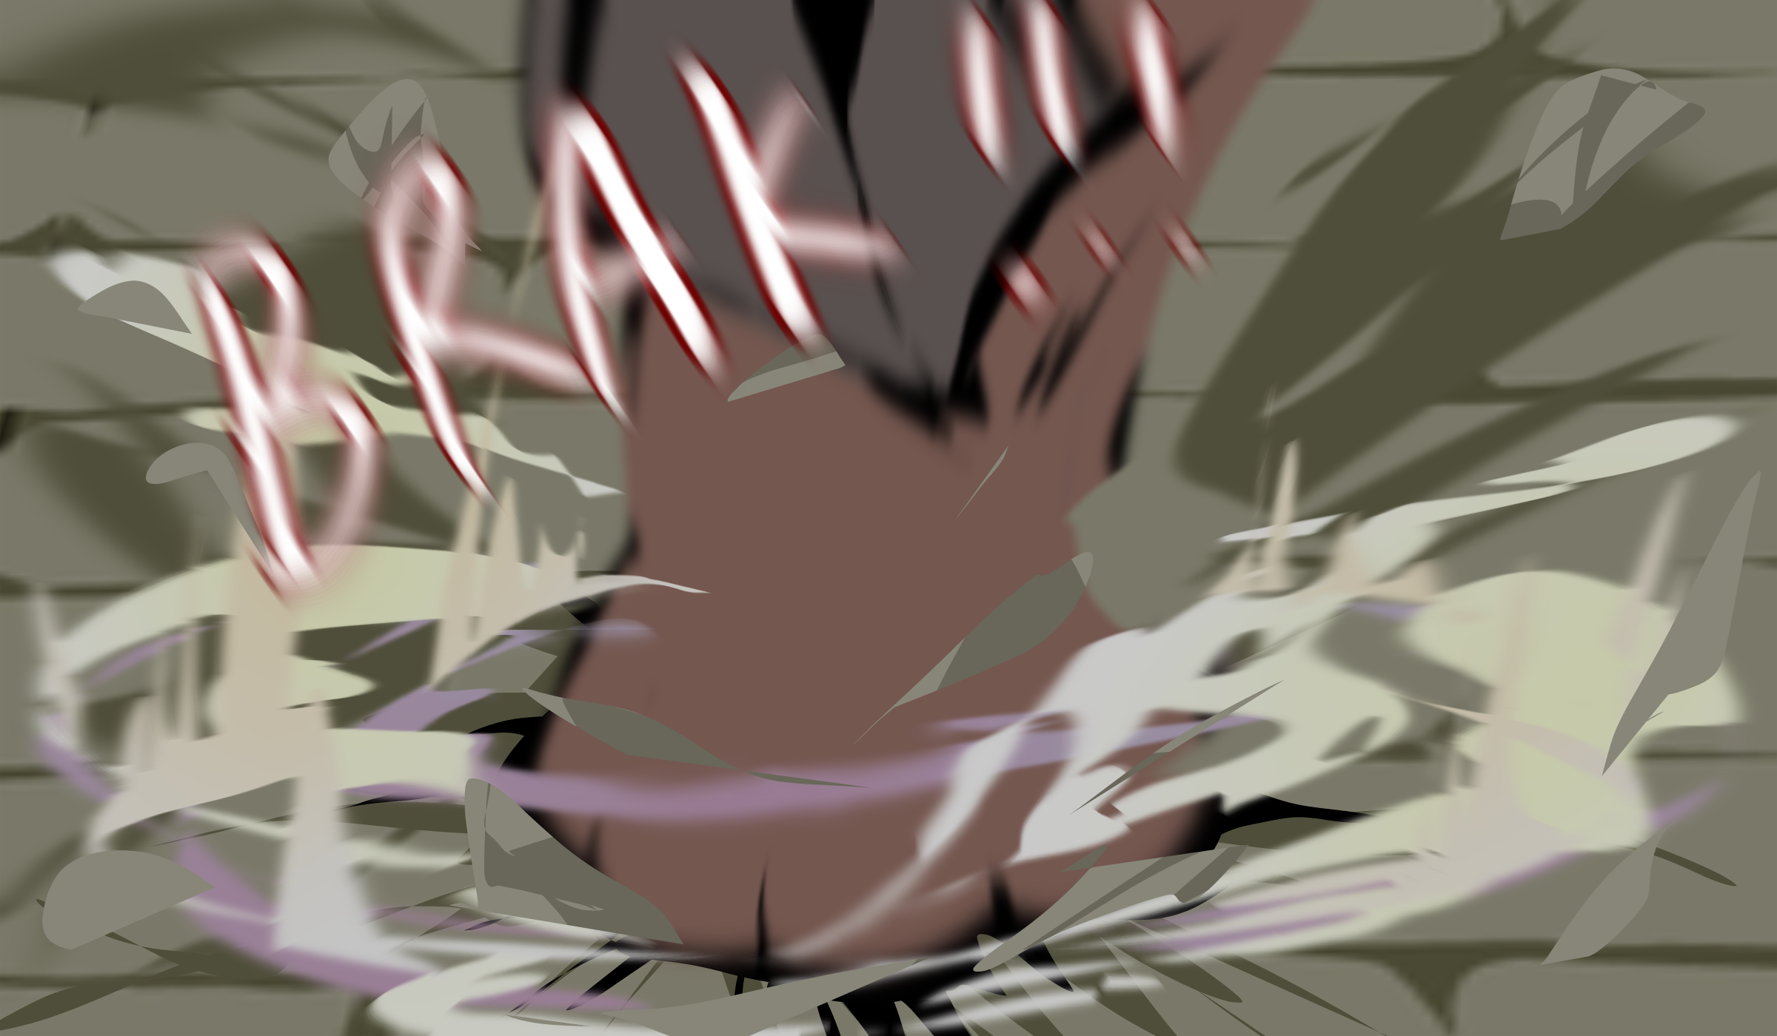

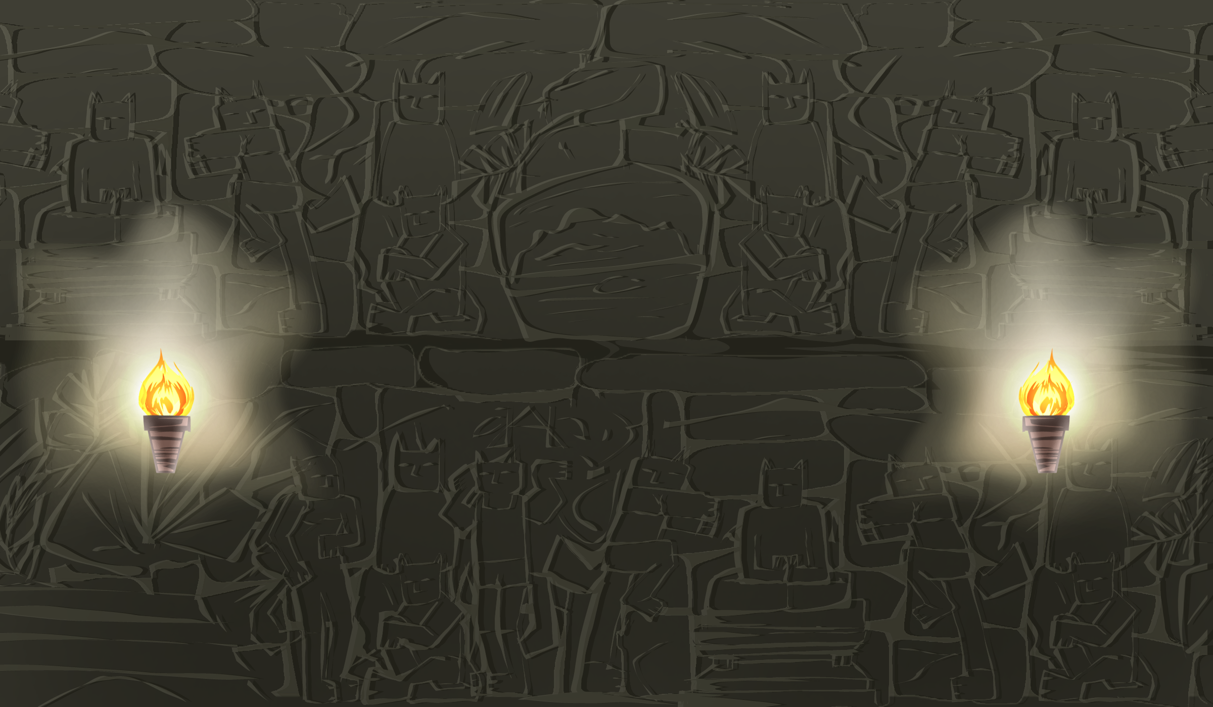
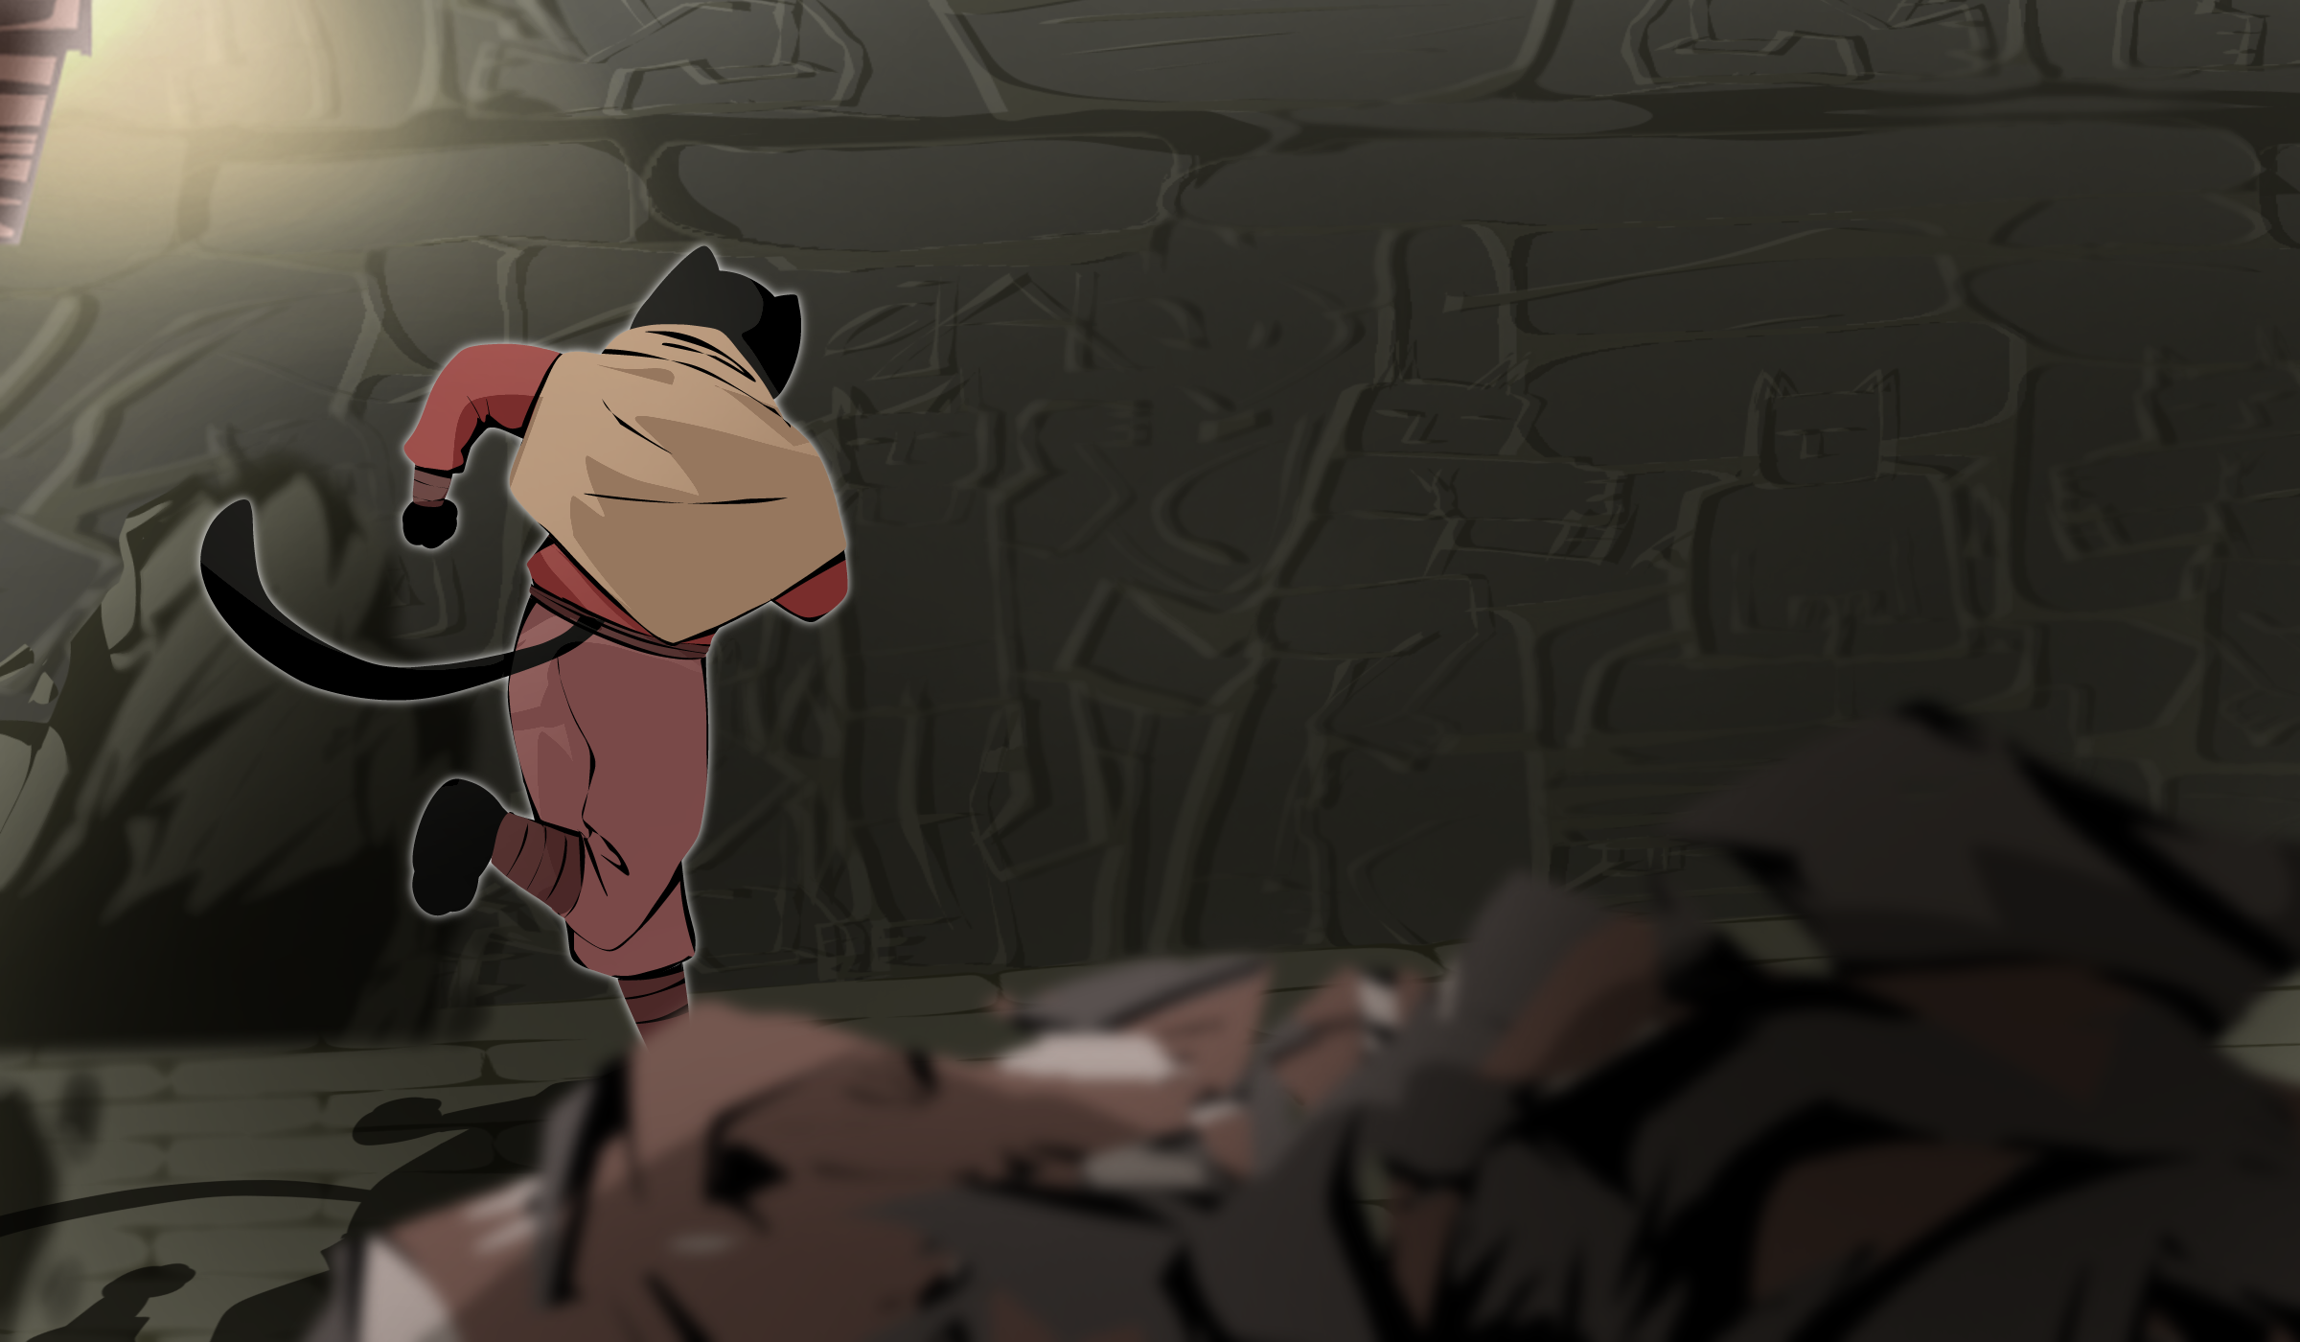

ART
Assets and Background
Cutscene
Prolog
Cutscene
Meet Big Boss
Cutscene
Epilog

Slide 8
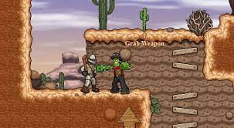
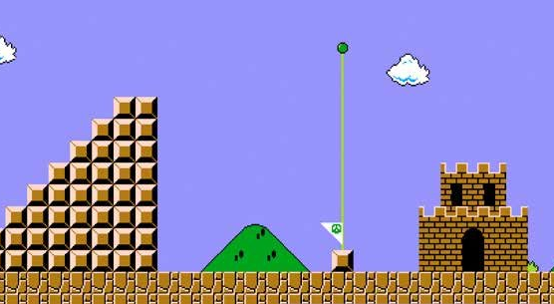
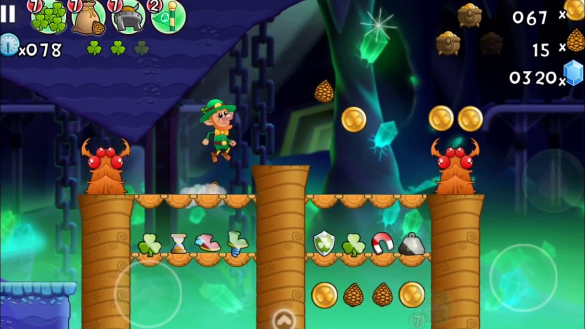
INSPIRATION AND REFERENCE
Cactus McCoy
Super Mario Bros
Leps World

Slide 9
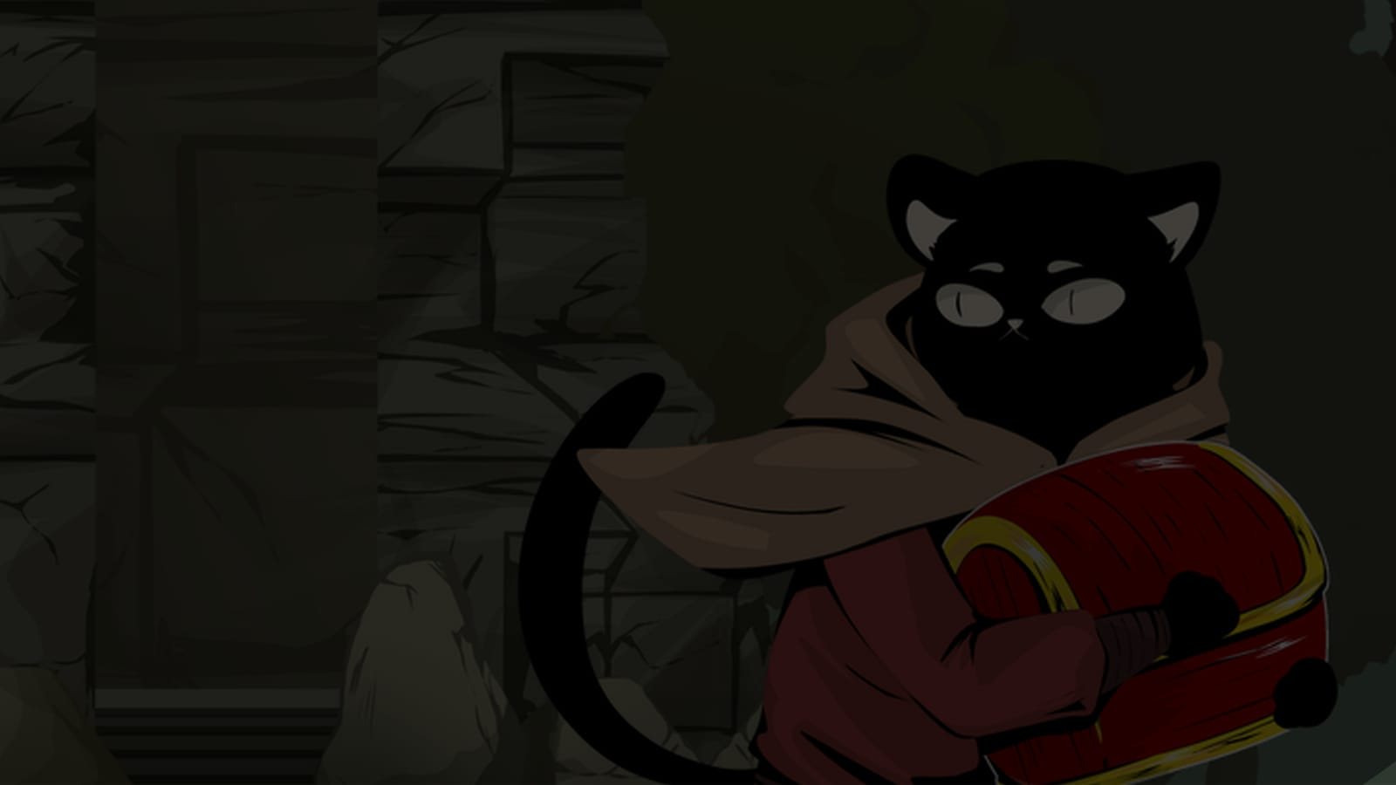





MUHAMMAD MIQDAD
AMALIYA HISANA NASUTION
RIO IMAM PRADANA
Game Designer
Game Manager
Lead Artist
Game Programmer
DINIYATUL FATMA
YUDHA SETYA WICAKSANA
Game Programmer
Game Artist

Slide 10

THANKYOU!
By:

